Slide 1
MS Directed Project Update
Chad Mirkovich

Slide 2
Bug Found
Bug was found within the CQ6/CQ7 identification algorithm
CQ6 and CQ7 elements were being correctly identified and solved as CQ6 and CQ7 elements
However: The newly identified CQ6 & CQ7 elements were NOT removed from the CQ8 element list.
This meant that there was a CQ6 or CQ7 element with a duplicate CQ8 on top of the CQ6/CQ7 element
This duplicate element was the source of the stress discontinuities
Fixing this bug shows the CQ8 models now converging sooner than CQ4 element model as expected

Slide 3
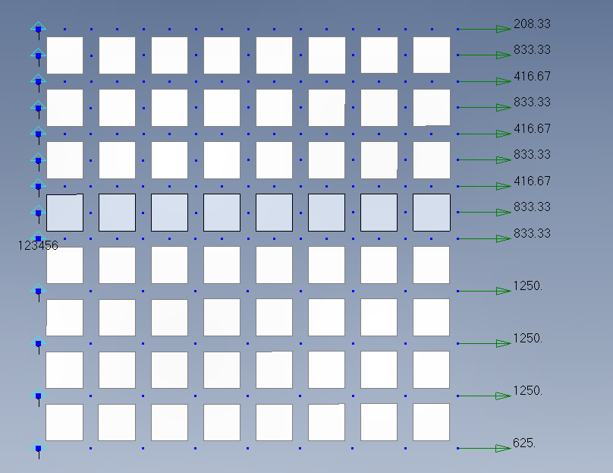
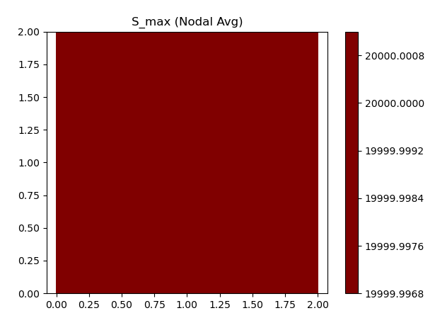
Mixed CQ4 and CQ8 Plate With CQ7 Transition
Constant tensile stress as expected

Slide 4
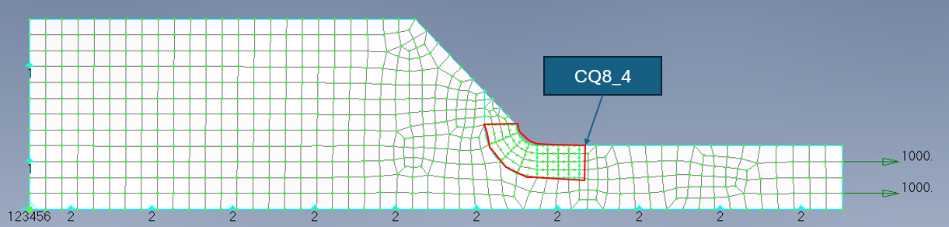
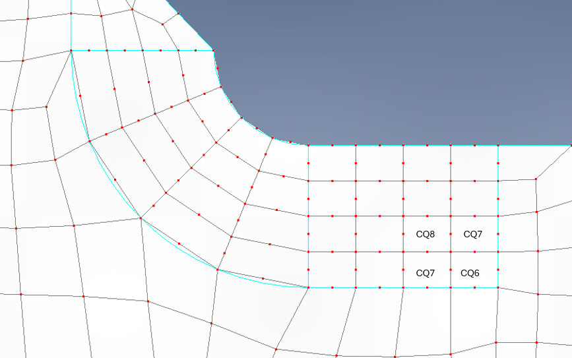
Stress Concentration Determination
DFEM Setup
DUPLICATE CQ8 & CQ6/7 Elements WAS PRESENT
Free Nodes

Slide 5
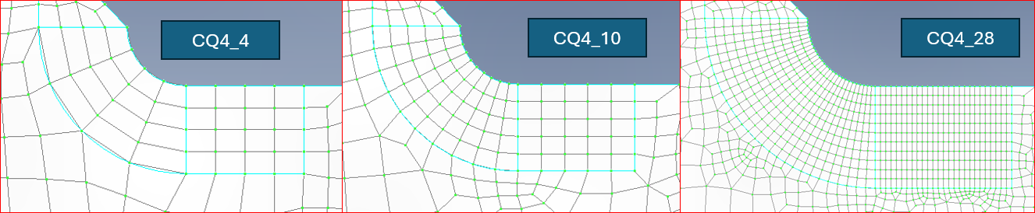
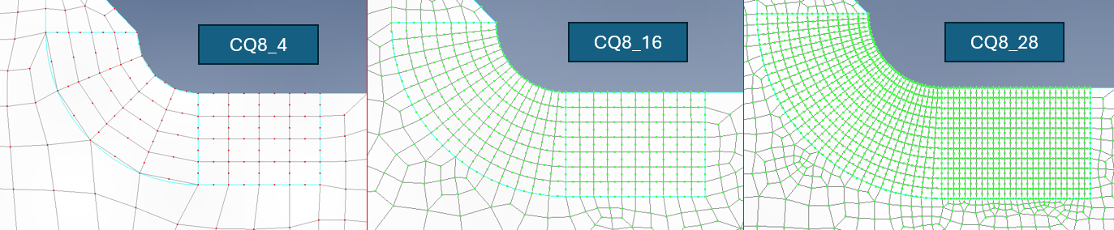
DFEM Refinement

Slide 6
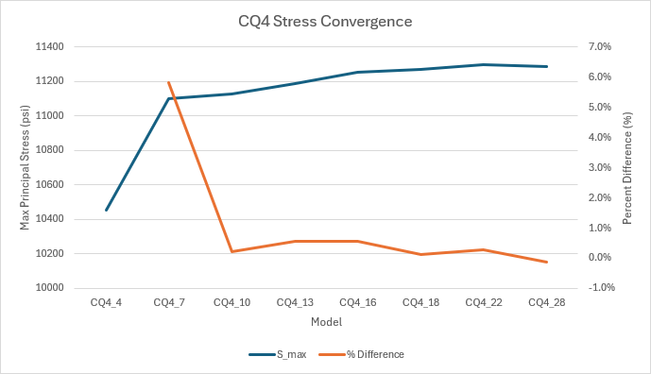
CQ4 Stress Convergence
Model | Element | NID | S_max | S_min | % Difference
CQ4_4 | 4 | 5 | 10456 | 1468
CQ4_7 | 493 | 547 | 11103 | 2361 | 5.8%
CQ4_10 | 969 | 960 | 11128 | 1966 | 0.2%
CQ4_13 | 1544 | 1468 | 11191 | 2280 | 0.6%
CQ4_16 | 2161 | 2021 | 11254 | 1835 | 0.6%
CQ4_18 | 3740 | 3429 | 11270 | 1863 | 0.1%
CQ4_22 | 11701 | 9515 | 11300 | 1533 | 0.3%
CQ4_28 | 13941 | 13338 | 11287 | 1565 | -0.1%
Unchanged

Slide 7
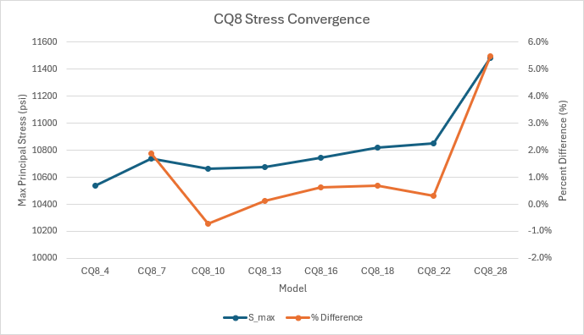
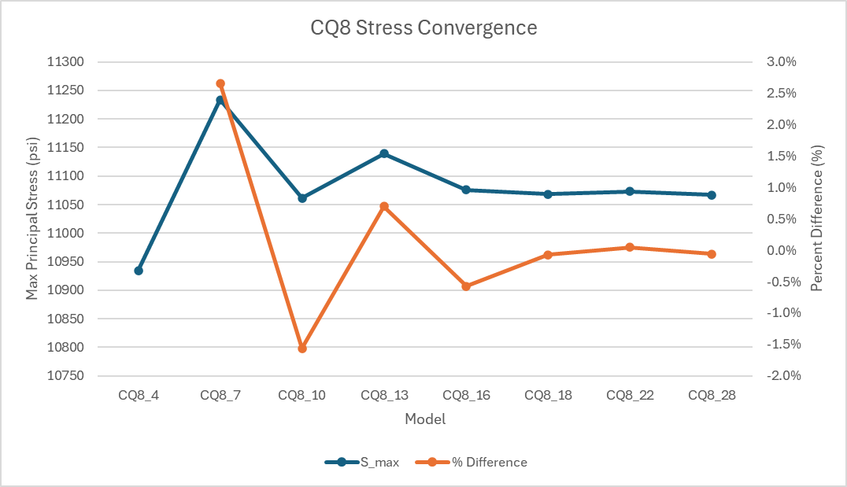
CQ8 Stress Convergence
Was
Is

Slide 8
CQ8 Stress Convergence
Model | Element | NID | S_max | S_min | % Difference
CQ8_4 | 999 | 6 | 10536 | 1695
CQ8_7 | 1481 | 547 | 10738 | 1066 | 1.9%
CQ8_10 | 2146 | 961 | 10661 | 1257 | -0.7%
CQ8_13 | 2754 | 1468 | 10676 | 945 | 0.1%
CQ8_16 | 3718 | 2021 | 10744 | 626 | 0.6%
CQ8_18 | 4875 | 3429 | 10819 | 780 | 0.7%
CQ8_22 | 9851 | 9515 | 10853 | 544 | 0.3%
CQ8_28 | 11966 | 14589 | 11483 | 2381 | 5.5%
Modelz | Element | NID | S_max | S_min | % Difference
CQ8_4 | 999 | 6 | 10935 | 1762
CQ8_7 | 1481 | 547 | 11234 | 1122 | 2.7%
CQ8_10 | 2146 | 961 | 11061 | 1304 | -1.6%
CQ8_13 | 2754 | 1468 | 11139 | 987 | 0.7%
CQ8_16 | 3718 | 2021 | 11076 | 646 | -0.6%
CQ8_18 | 4875 | 3429 | 11068 | 798 | -0.1%
CQ8_22 | 9851 | 9515 | 11073 | 555 | 0.0%
CQ8_28 | 11701 | 13338 | 11067 | 587 | -0.1%
Converging on a much closer value to that of the CQ4 Model
Was
Is

Slide 9
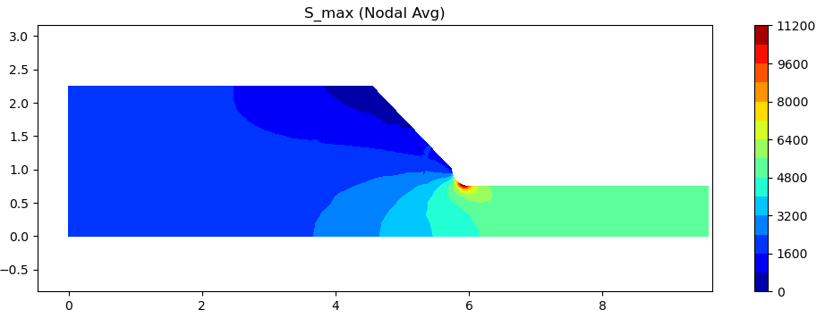
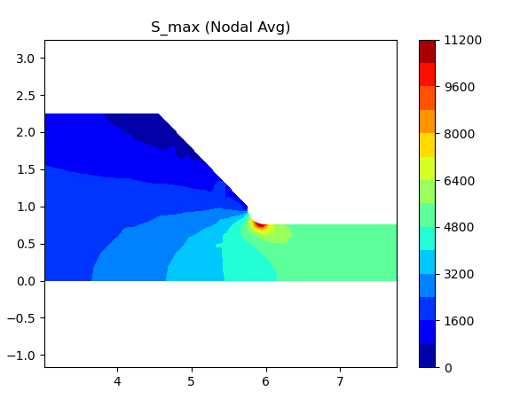
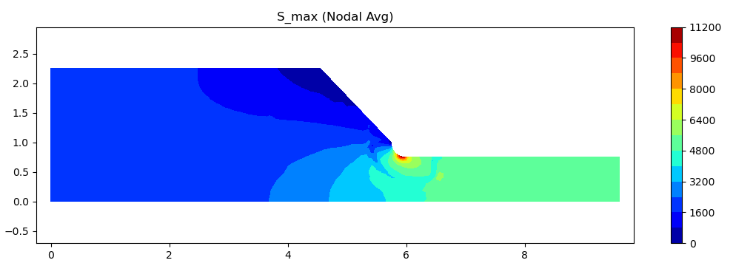
Stress Plot Comparison
CQ4
CQ8/7/6
IS
CQ8/7/6
WAS
No Discontinuities
Discontinuities

Slide 10
Conclusions
The Python FEM solver accurately computed displacements, strains, and stresses for CTRIA3, CQUAD4, CQUAD8, and transition CQUAD6/7 elements
CQ4 meshes converged reliably, while CQ8 meshes failed to converge, likely due to transition-zone distortion and abrupt mesh-quality changes
CQ8 elements introduced extra DOFs and computational cost without improving accuracy or convergence speed
Transition regions (CQ6/CQ7) caused stress peaking and distortion, reducing CQ8 effectiveness
Recommendation: use CQ4 refinement; CQ8 with transition elements do not offer a practical advantage
CQ8 model does converge sooner than the CQ4 model as expected!

